Slide 1
Tower DEFENSE
TEAM NAME: TOWER HACKERS
TEAM MEMBERS:
Shubham Goyal
Andrew Vandenburgh
Christopher Bilinski
Dorsey Beckles

Slide 2
Project Description
pygame tower defense game turret bots
We use the quadratic formula to predict were the enemies will be and the speed of the bullet to aim and destroy as many enemies as possible
Our final solution uses hard coded frame based Howitzers that are able to get all the enemies with lowest utilization

Slide 3
OTHER Attempts
We close to perfect utilization on our machines with two solutions
First one used two auto cannons with tracking
Second one uses one auto cannon with tracking and one howitzer that shoots straight down
We had one solution with one auto cannon with really good aiming but it let through 13-14 enemies which drastically lowered the score.

Slide 4
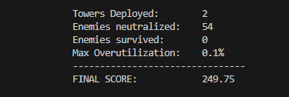
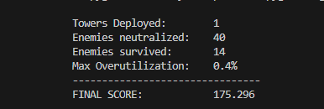
Scores
2 Basic Auto Cannon
1 Howitzer and 1 Basic Auto Cannon
Towers Deployed: 2 Enemies neutralized: 54 Enemies survived: 0 Max Overutilization: 0.2% -------------------------------- FINAL SCORE: 249.5
This solution uses 2 Howitzers with no auto aim
This is from Host’s computer and the best score from previous scores 249.25
One Auto Cannon

Slide 5
Tower HaCKERS JOURNEY
Howitzer got NERFED
One CANNON was replaced by DUMB HOwitzer
3
TWO AUTO CANNONS GOT THEM ALL
8
DONE! ☺
2
6
1
Day 1
Howitzers was overpowered and solved all problems
7
4
One CANNON with really good aim got a lot
TWO DUMB HOWITZERS GOT the best util
UTILIZATION IMPROVEMENTS IS Now the focus
5

